Slide 1

GOKARAJU RANGARAJU INSTITUTE OF ENGINEERING AND TECHNOLOGY Department of Computer Science and Engineering Real-time Research Project/ Societal Related Project Review-0
Dormconnect
A User-Friendly Website for Hostel Reviews & Accommodation Insights
~ Dr.G. RAMESH
Associate Professor
B.Rishitha-23241A0573
K.Sunaina-232451A0590
K.Hemasree-232451A0593

Slide 2
ABSTRACT
-The proposed project aims to develop a user-friendly website for GRIET college girls who are in search of good hostels. The platform will serve as a comprehensive guide, offering detailed reviews of hostel food, accommodation facilities, pricing, and available slots. It will also feature feedback from seniors, helping new students make informed decisions about their hostel choices.
- The website will include functionalities such as hostel listings with ratings, real-time accommodation availability, and a review submission system. Users can browse through various hostels and compare amenities by themselves. Seniors and current residents can contribute by sharing their experiences, ensuring authentic and
up-to-date information.

Slide 3
MAIN GOALS
Provide detailed hostel reviews (food, amenities, pricing).
Enable students to browse hostels and check availability.
Allow seniors to share their experiences for future students.
Ensure authentic and up-to-date information.
KEY FEATURES OF THE WEBSITE
Real-time Accommodation Availability
Review Submission System (by seniors & current residents)
User-friendly Interface

Slide 4
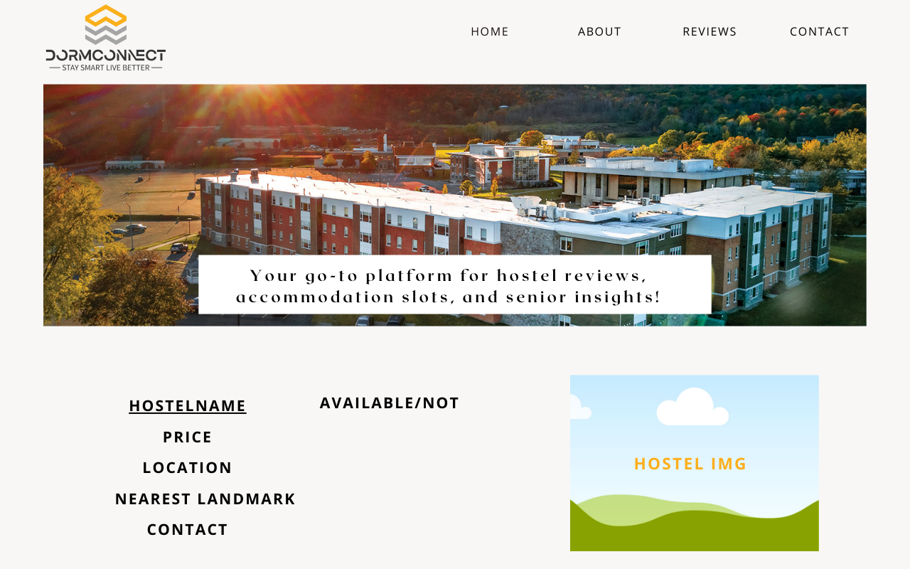
Look alike of the website

Slide 5
TARGET USERS:
New Students: To find suitable hostels
Seniors: To share their experiences
Hostel Management: To update availability
USER FLOW:
Students visit the website → Browse hostels
Check reviews, pricing, & amenities
Read senior feedback → Make an correct decision
Submit reviews

Slide 6
Technology Stack & Implementation
Frontend: HTML, CSS, JavaScript (React.js or Vue.js)
Backend: Node.js, Express.js (or Django/Flask)
Database: MySQL / MongoDB
Hosting: AWS, Firebase, or Heroku
Other Tools: Google Maps API for location-based search

Slide 7
Expected Benefits & Impact
For Students:
Find trustworthy hostel reviews easily
Make better accommodation choices
For Hostel Owners:
Increase visibility & trust
Improve services based on feedback
For Seniors:
Help juniors with authentic experiences

